Slide 1


Medical Appointment Web Application Hosted in AWS Interim Report - Abraham Izarra

Slide 2

MedEire is a medical web application designed to increase the efficiency of scheduling and managing medical appointments.

Slide 3




Objectives
Online medical appointment
Manage Appointments
Internal live chat
Access to medical records

Slide 4






Project background

Slide 5
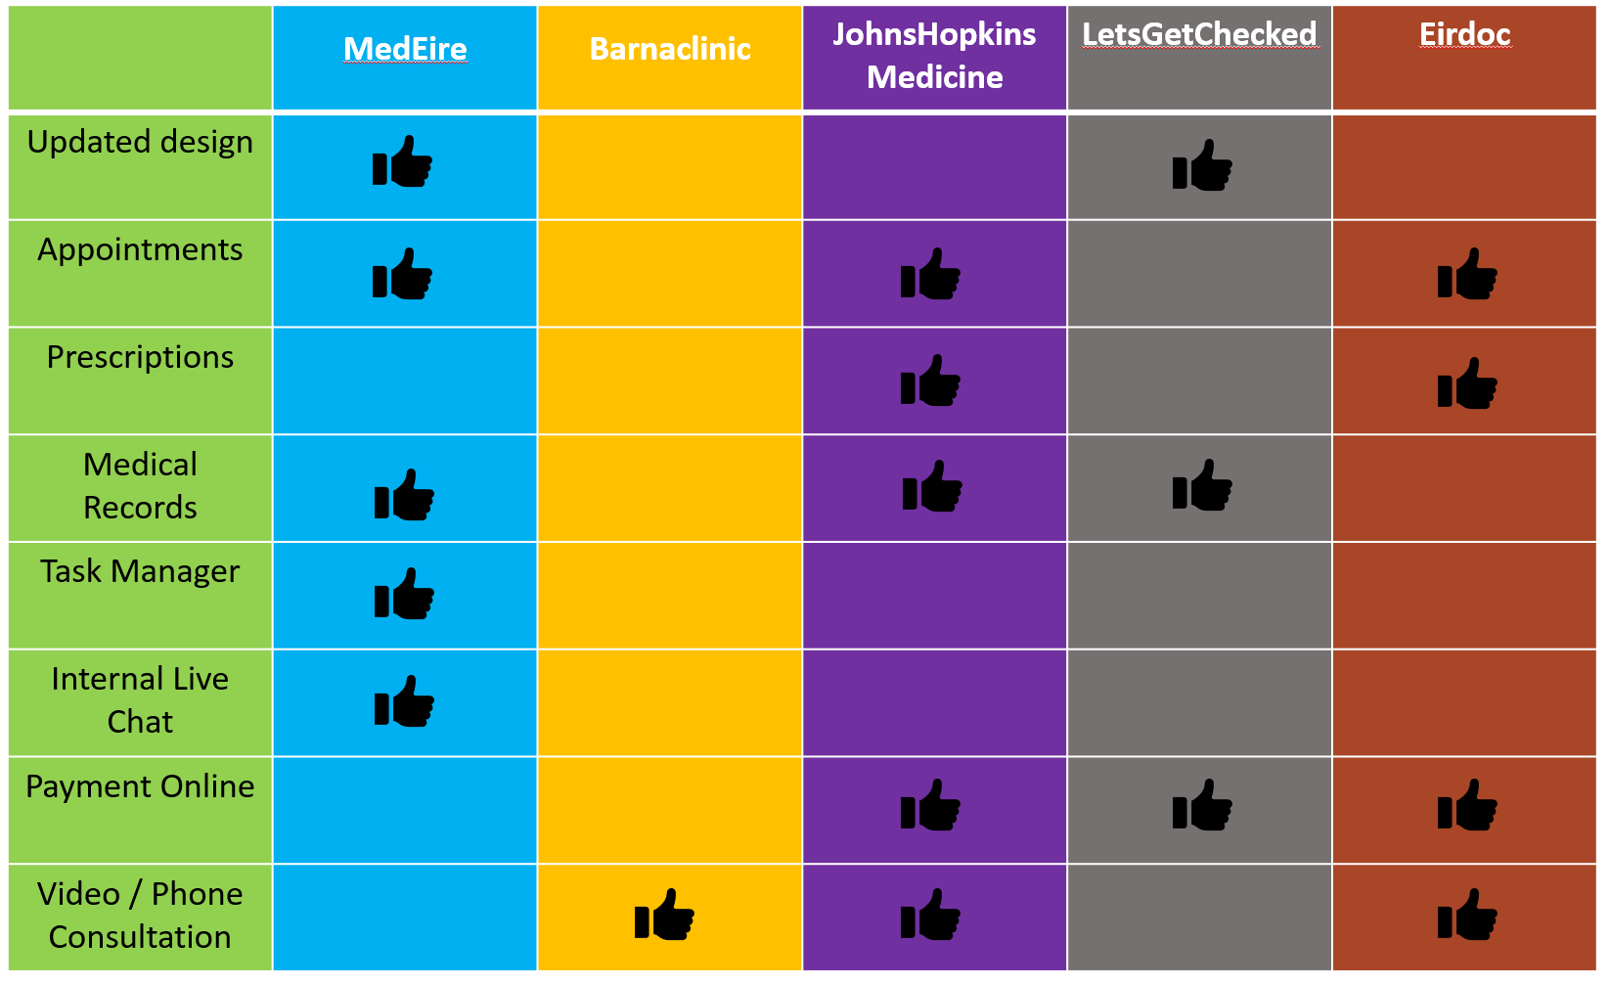
Functionality Comparison

Slide 6

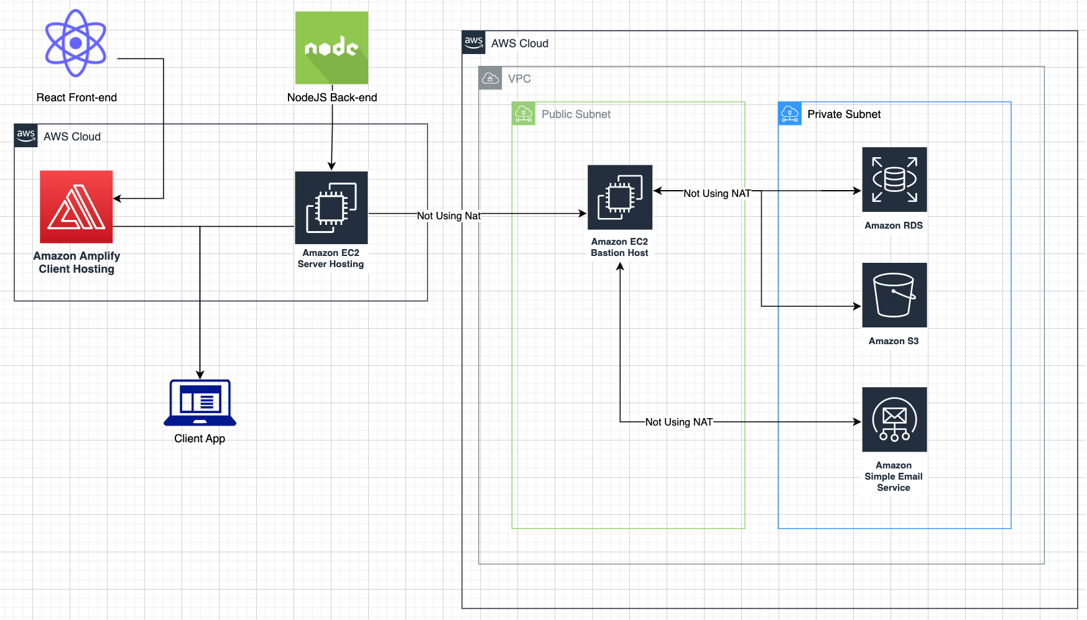
Web Architecture
Technology Implemented
React is being used for the front-end.
Node.js as the back end.
EC2 within a VPC in a public subnet using an internet gateway.
EC2 is acting as a bastion host for the other AWS services that are within the same VPC but inside a private subnet for extra security.

Slide 7

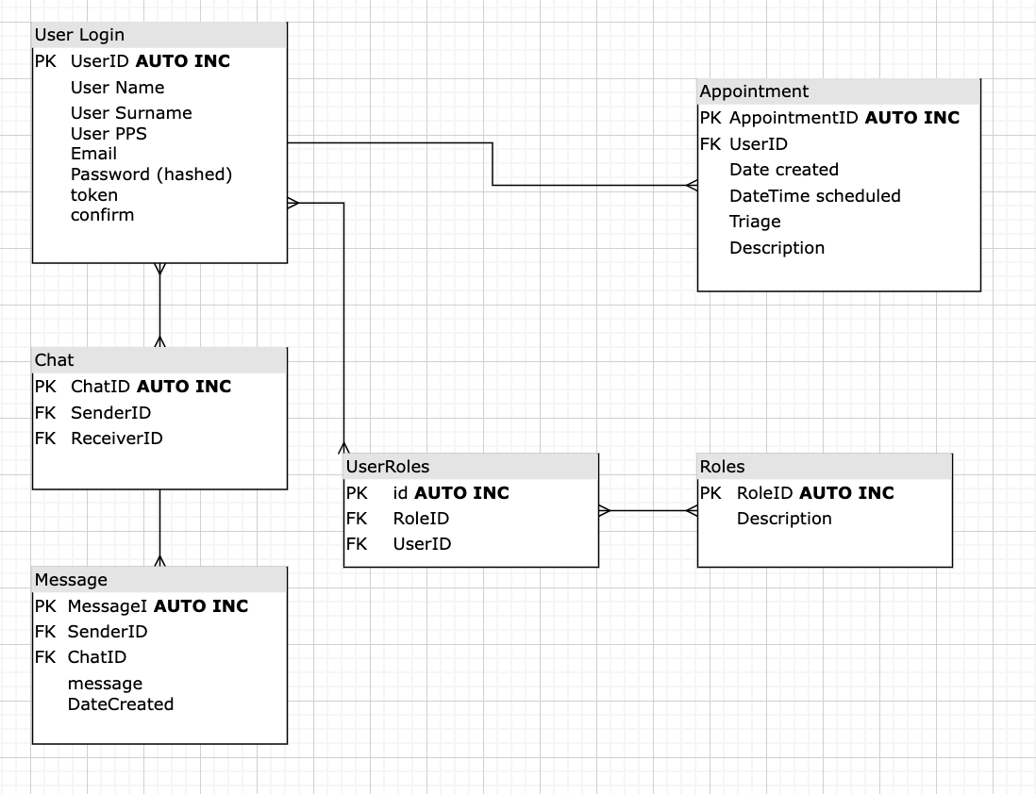
Database Tables
Queries
INSERT INTO Appointment (Patient-ID, Patient-Name, Patient-PPS, Staff-ID, Staff-Name) VALUES (1200, Abraham, Izarra, 1234, 2200, Dr David, Today, Check-up, Mild headache);
• INSERT INTO Chat (Chat-ID, senderID, receiverID) VALUES (9999, 2200, 1231);

Slide 8
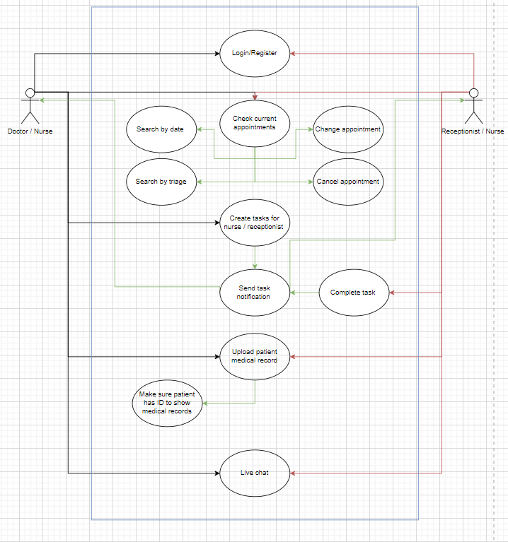
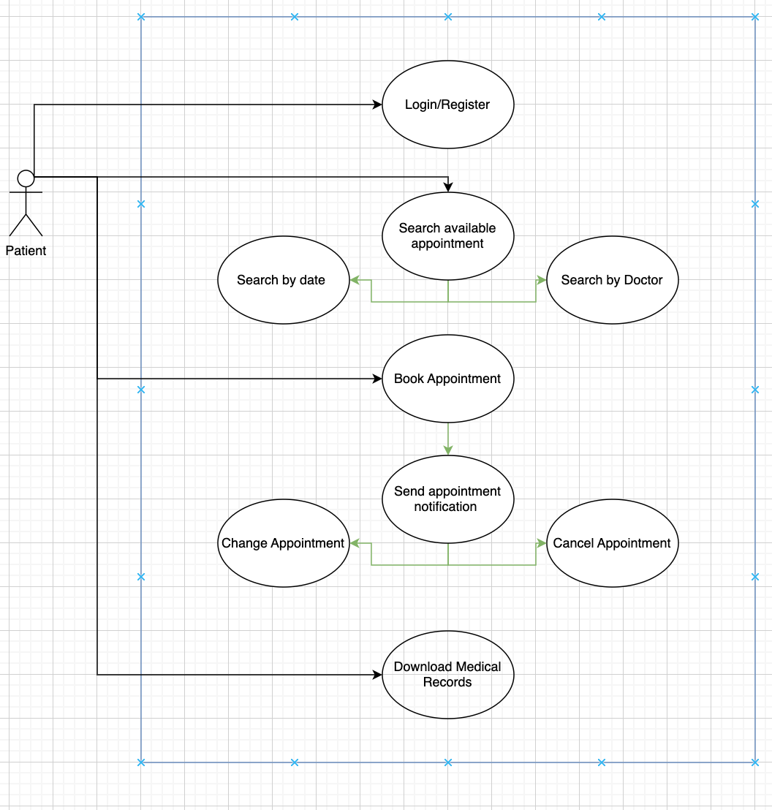

System
Patient UML Diagram
Doctor, Nurse, and Receptionist UML Diagram

Slide 9
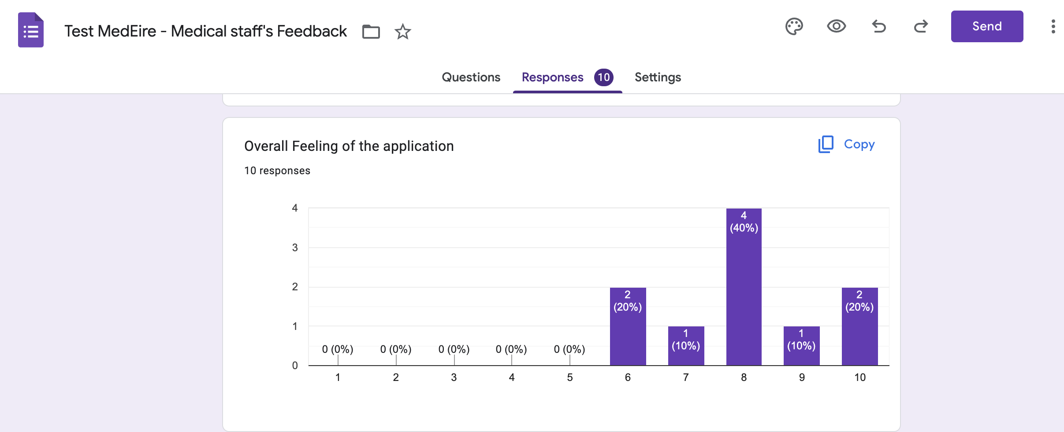
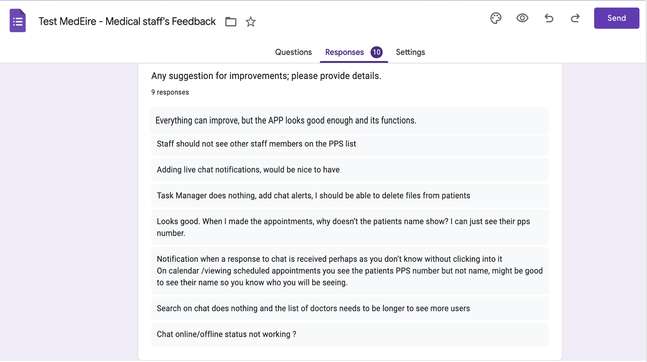
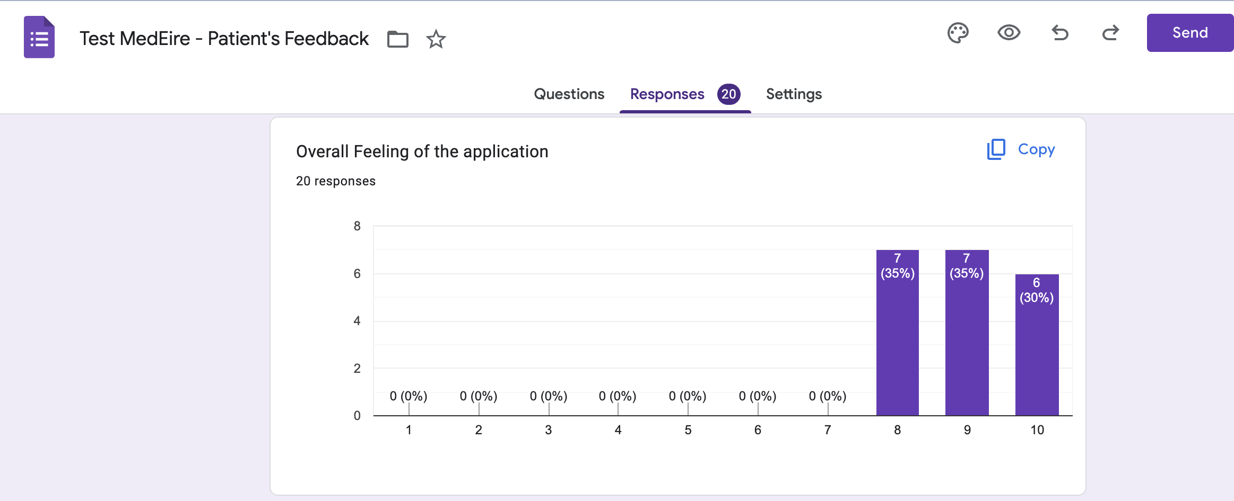
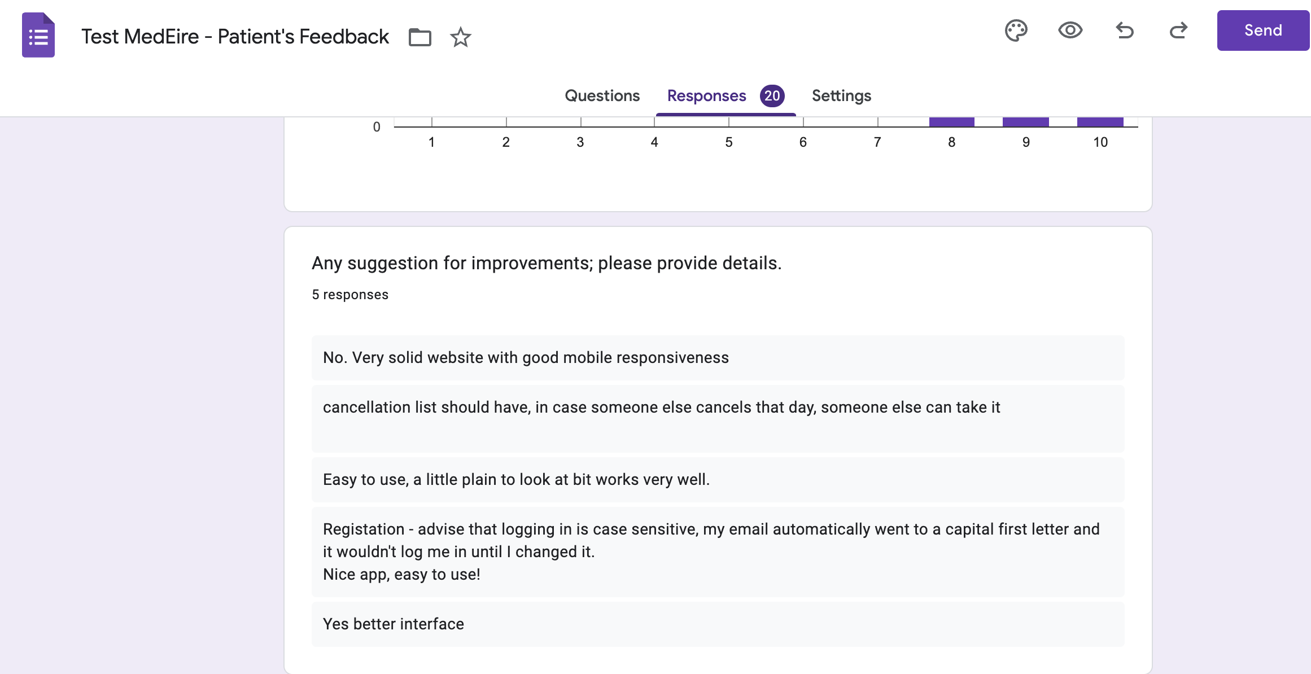

Removing other staff members from the PPS list was added
Chat notifications is a big changed for later stage
Search on the chat is thought for later stage
Task manager is a changed for next stage
Patient name added
Cancellation list is a good change that could be implemented in next iterations
Interface is also planned to improve
Changed registration to remove case sensitivity
Removed unavailable appointment time from list
Changed logout hover effect.

Slide 10
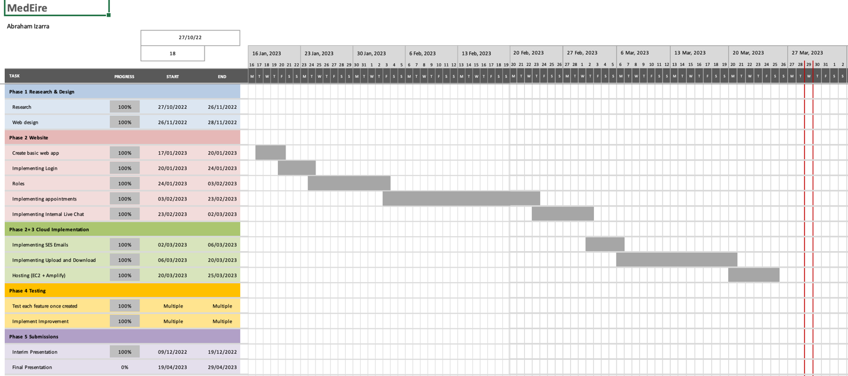
GANTT CHART

Slide 11

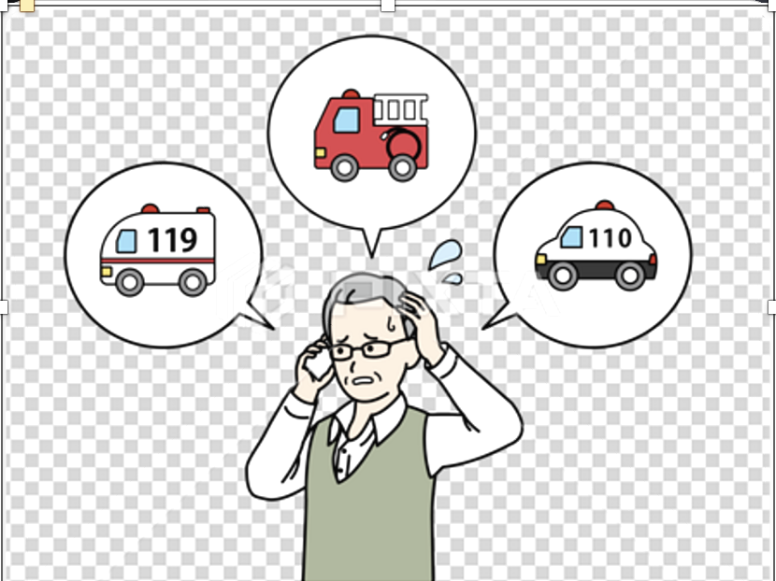
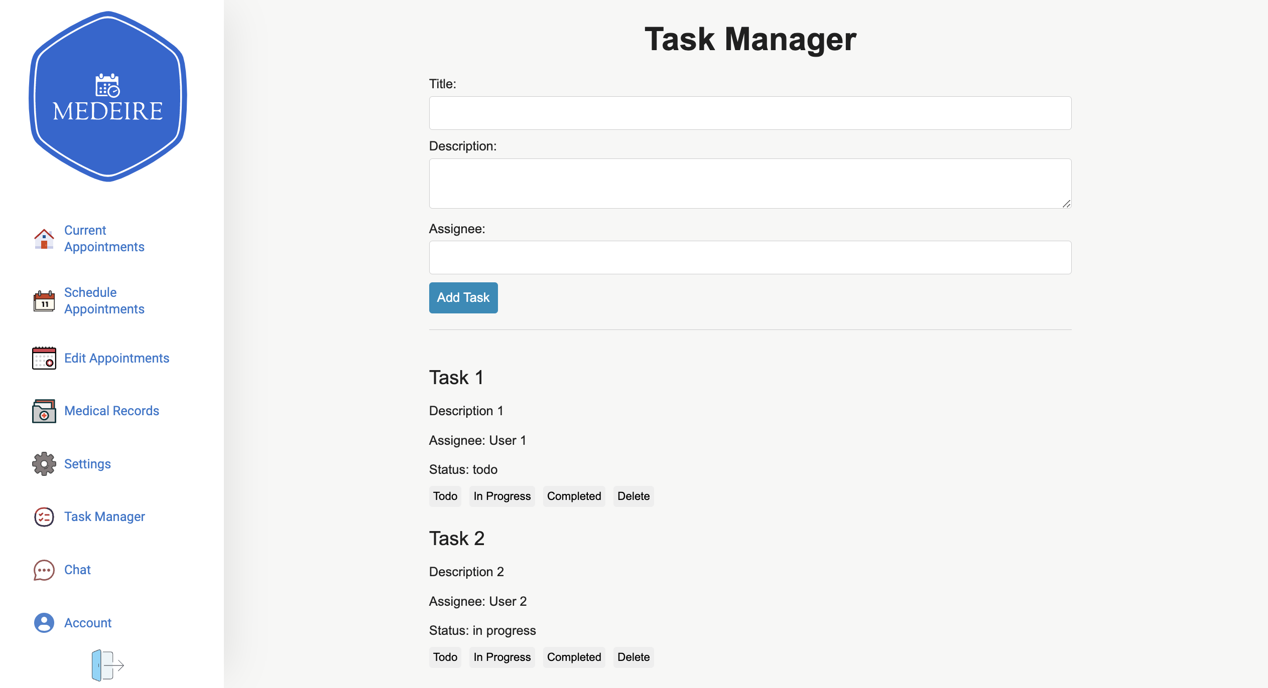


Issues
Future Work

Slide 12


Slide 13



